Slide 1

Group 4 “Green on the Go!” App
An app designed to educate adults and children about the dangers of improper environmental care and teach kids about proper recycling and disposal.
Project Manager: Pelumi Omole
Artists:Alec Handal & David Rodriguez
Java Programmers: Abhinav Komaravalli & Alec Handal

Slide 2
What is this app for?
This app is being developed for the Museum of Discovery and Science to make visiting the “Go Green” exhibit more intuitive and fun, as well as to educate visitors on environmental care and going green. We want visitors to actively participate in a green lifestyle both inside and outside of the museum, and we are going to do this through the inclusion of fun activities such as a game and trivia within the app. These activities will entertain the user while teaching them about the environment, proper recycling, and health. Children are the target demographic for this app.

Slide 3
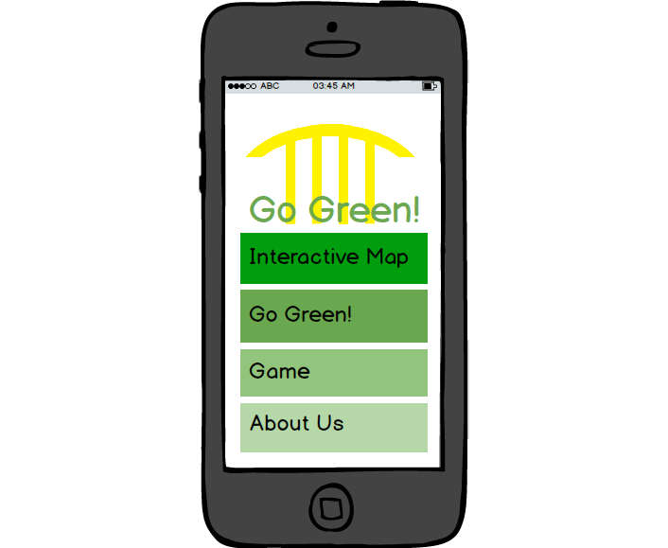
Menu
-The menu will be a simple, colorful gateway to the many different sub-applications within the app. Bright greens will be displayed all over the app with complimenting whites to create a pleasant look.
- 4 Options available: “Interactive Map”, “Go Green!”, “Game”, and “About Us.”

Slide 4
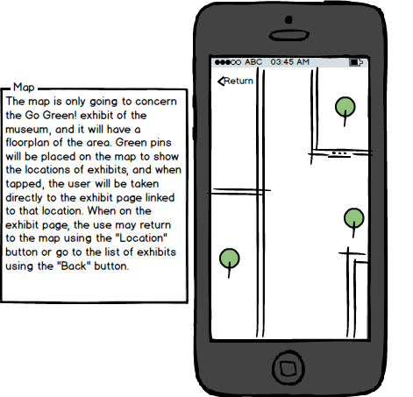
Interactive Map
Map
-The map that is presented in our app will be based on the floor plans available on the official museum webpage. Only the “Go Green” exhibit will be included in the map, as that is what the tool is designed for.
-The map will be navigated through swipes and rotations, similar to the movement model present in Google Maps for Android.
-Pins will show the locations of different exhibits. Tapping on a certain exhibit’s marker will take you straight to the information page about that exhibit in the “Exhibits & Activities” section of the “Go Green!” sub-menu.

Slide 5
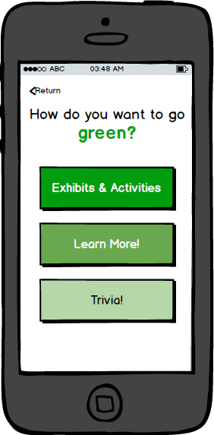
Going Green!
-Three options will be available: Exhibits & Activities, Learn More, and Trivia.
-The Exhibits & Activities option is present to inform visitors about the different stops present in the museum’s “Go Green” exhibit. A list of all the attractions will be displayed and fully swipeable. When an attraction is selected, visitors will be informed about the target age, type of exhibit, and what the exhibit is through a short description. This makes visiting more simple and enjoyable.
-The Learn More option will contain articles on how people can go green at home, teach about different environmental issues, and promote healthy living as well.
-The Trivia section will contain fun facts that will wow both kids and adults, and promote green living in a fun and interesting way.

Slide 6
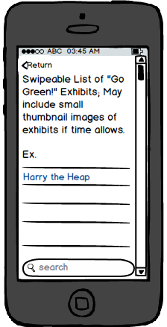
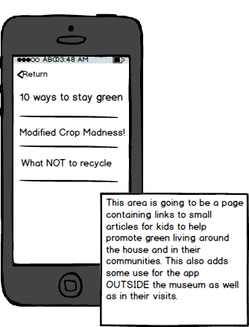
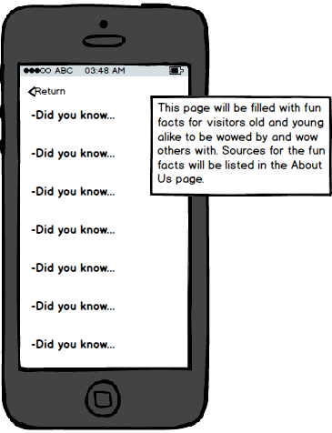
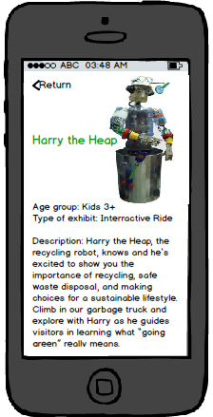
Exhibits & Activities
Learn More!
Trivia!
Option tapped:

Slide 7
“Race to Recycle” Interactive Game
-No images of the game are currently available, as assets and gameplay have yet to be finalized. Our image for the game is for a simple, easily-accessible, and fun experience that will not only entertain the user of the app, but also teach them about how to recycle and what can and can NOT be recycled. No main menu is necessary; The game is started with a simple tap on the screen. 3 objects will appear, and the user is to tap the object that can be recycled. If they guess correctly, they get a point, and otherwise it's game over. The player only has 60 seconds to rack up as many points as they can, and this competitive challenge will promote kids to tell their friends about the game and compare scores with each other. Not only will this spread the fun, but it also will teach kids about proper recycling everywhere.

Slide 8
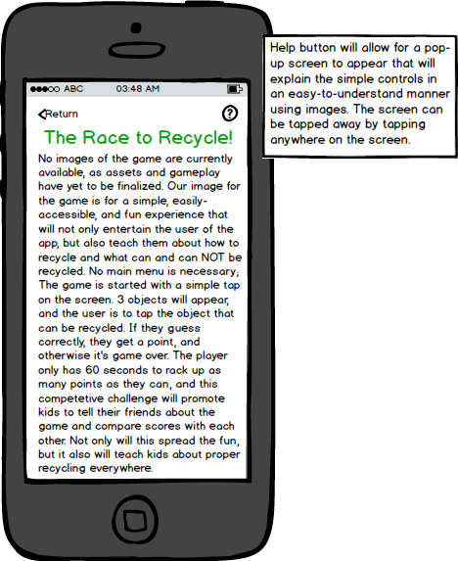
“Race to Recycle” Concept Text

Slide 9
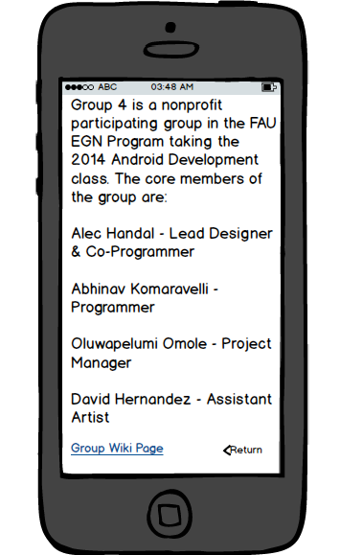
“About Us”
This last page will be a simple credits page listing Group 4’s members and positions. At the bottom of the page will be a link to the Group 4 wiki page, and our attachment to the FAU ESP program will be mentioned. Special thanks will be given to our instructor and TAs, as well as the sources of our trivia and the museum information.

Slide 10
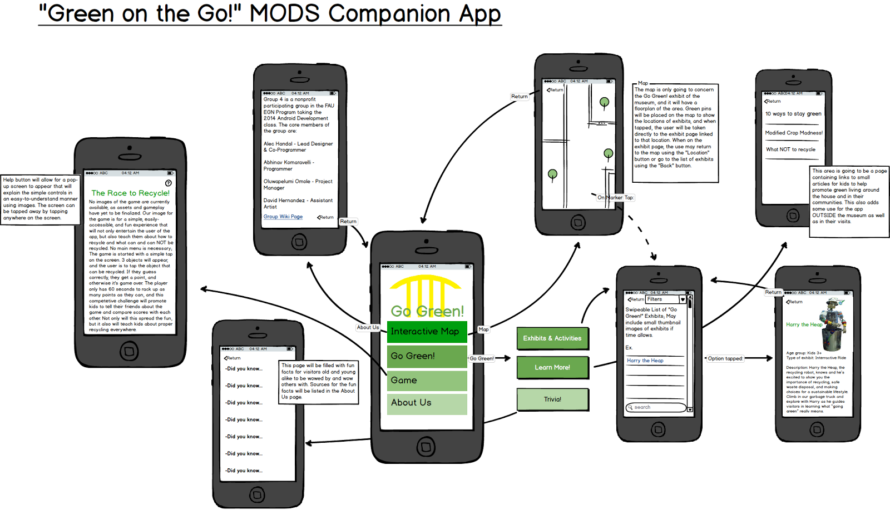
Complete Mockup
Interactive mockup available on Balsamiq

